Slide 1
Announcements
HW2 is due Friday, February 10, 11:59 PM PT
Project 2 is due Tuesday, February 14, 11:59 PM PT

Slide 2

CS 188: Artificial Intelligence
Constraint Satisfaction Problems
Spring 2023
University of California, Berkeley
[These slides were created by Dan Klein and Pieter Abbeel for CS188 Intro to AI at UC Berkeley. All CS188 materials are available at http://ai.berkeley.edu.]
Notes:
Please retain proper attribution, including the reference to ai.berkeley.edu. Thanks!

Slide 3

What is Search For?
Assumptions about the world: a single agent, deterministic actions, fully observed state, discrete state space
Planning: sequences of actions
The path to the goal is the important thing
Paths have various costs, depths
Heuristics give problem-specific guidance
Identification: assignments to variables
The goal itself is important, not the path
All paths at the same depth (for some formulations)
CSPs are a specialized class of identification problems

Slide 4

Constraint Satisfaction Problems

Slide 5

Constraint Satisfaction Problems
Standard search problems:
State is a “black box”: arbitrary data structure
Goal test can be any function over states
Successor function can also be anything
Constraint satisfaction problems (CSPs):
A special subset of search problems
State is defined by variables X_{i} with values from a domain D (sometimes D depends on i)
Goal test is a set of constraints specifying allowable combinations of values for subsets of variables
Simple example of a formal representation language
Allows useful general-purpose algorithms with more power than standard search algorithms

Slide 6
CSP Examples

Slide 7


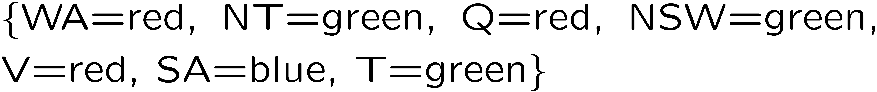
Example: Map Coloring
Variables:
Domains:
Constraints: adjacent regions must have different colors
Solutions are assignments satisfying all constraints, e.g.:
Implicit:
Explicit:

Slide 8

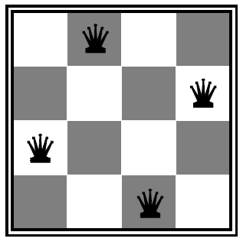
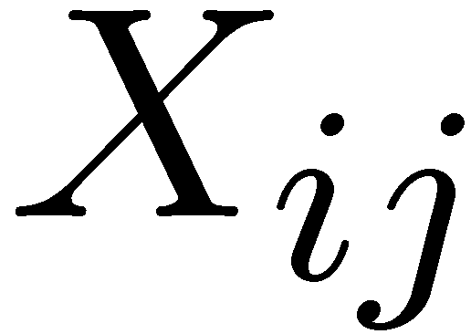

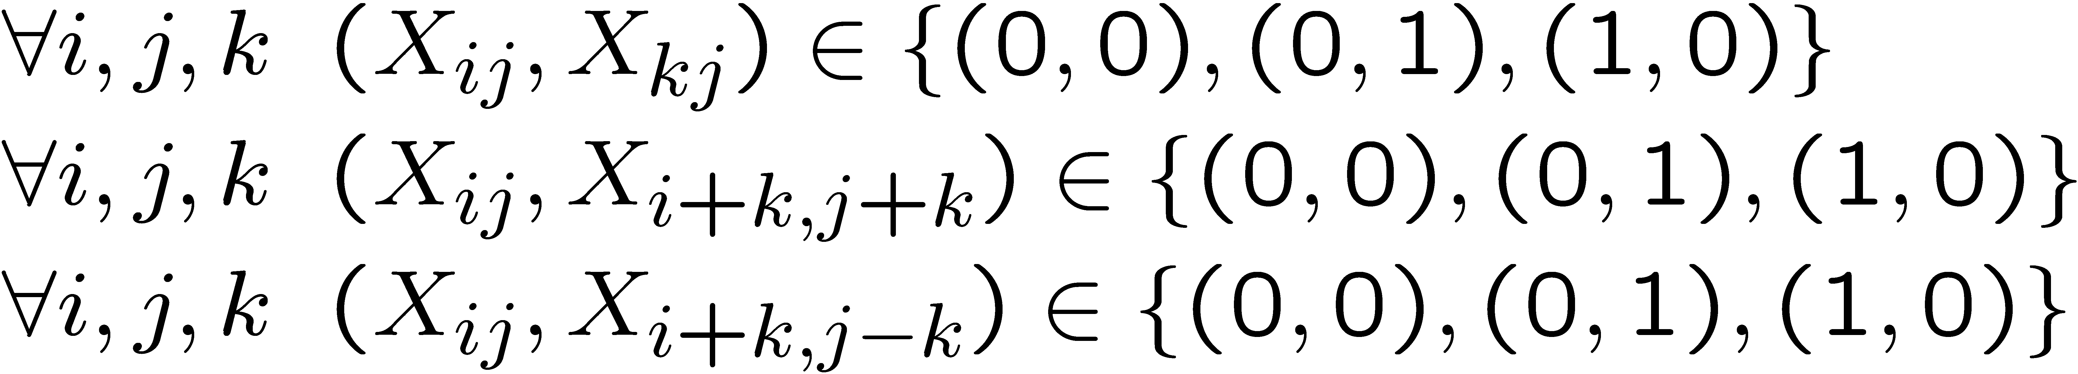
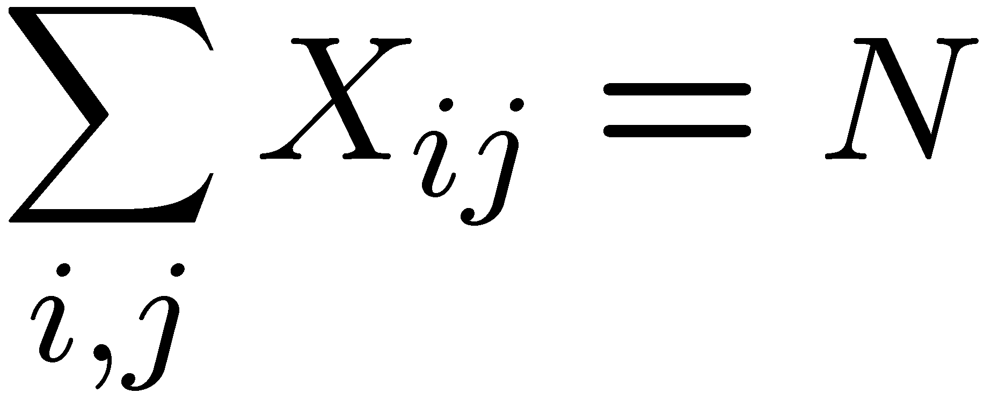
Example: N-Queens
Formulation 1:
Variables:
Domains:
Constraints

Slide 9







Example: N-Queens
Formulation 2:
Variables:
Domains:
Constraints:
Implicit:
Explicit:

Slide 10
Constraint Graphs

Slide 11
Constraint Graphs
Binary CSP: each constraint relates (at most) two variables
Binary constraint graph: nodes are variables, arcs show constraints
General-purpose CSP algorithms use the graph structure to speed up search. E.g., Tasmania is an independent subproblem!
[Demo: CSP applet (made available by aispace.org) -- n-queens]
Notes:
Demo:
Run constraint.jar or constraint.exe, load the 5 queens problem.
Demo is just showing the n-queens applet as illustration of constraint graph, but later in lecture we’ll interact with the applet.
aispace.org will have the latest version

Slide 12


Example: Cryptarithmetic
Variables:
Domains:
Constraints:
Notes:
0=7, R=4, W=6, U=2, T=8, F=1; 867 + 867 = 1734

Slide 13
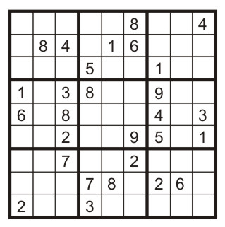
Example: Sudoku
Variables:
Each (open) square
Domains:
{1,2,…,9}
Constraints:
9-way alldiff for each column
9-way alldiff for each row
9-way alldiff for each region
(or can have a bunch of pairwise inequality constraints)

Slide 14


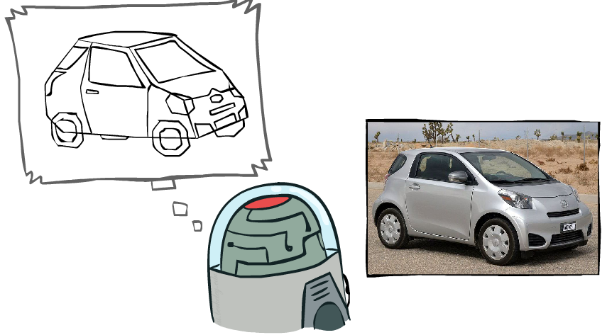
Example: The Waltz Algorithm
The Waltz algorithm is for interpreting line drawings of solid polyhedra as 3D objects
An early example of an AI computation posed as a CSP
?
Approach:
Each intersection is a variable
Adjacent intersections impose constraints on each other
Solutions are physically realizable 3D interpretations

Slide 15

Varieties of CSPs and Constraints

Slide 16

Varieties of CSPs
Discrete Variables
Finite domains
Size d means O(d^{n}) complete assignments
E.g., Boolean CSPs, including Boolean satisfiability (NP-complete)
Infinite domains (integers, strings, etc.)
E.g., job scheduling, variables are start/end times for each job
Linear constraints solvable, nonlinear undecidable
Continuous variables
E.g., start/end times for Hubble Telescope observations
Linear constraints solvable in polynomial time by LP methods (see cs170 for a bit of this theory)

Slide 17


Varieties of Constraints
Varieties of Constraints
Unary constraints involve a single variable (equivalent to reducing domains), e.g.:
Binary constraints involve pairs of variables, e.g.:
Higher-order constraints involve 3 or more variables:
e.g., cryptarithmetic column constraints
Preferences (soft constraints):
E.g., red is better than green
Often representable by a cost for each variable assignment
Gives constrained optimization problems
(We’ll ignore these until we get to Bayes’ nets)

Slide 18
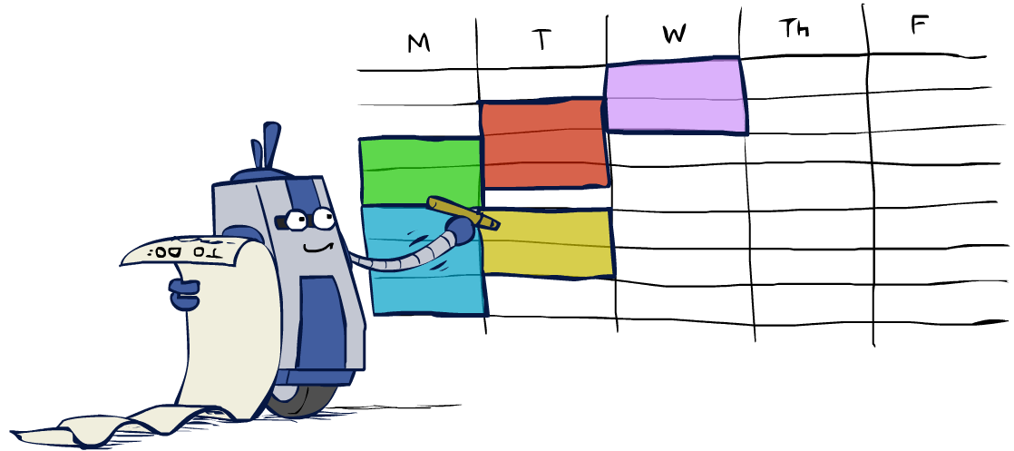
Real-World CSPs
Scheduling problems: e.g., when can we all meet?
Timetabling problems: e.g., which class is offered when and where?
Assignment problems: e.g., who teaches what class
Hardware configuration
Transportation scheduling
Factory scheduling
Circuit layout
Fault diagnosis
… lots more!
Many real-world problems involve real-valued variables…

Slide 19

Solving CSPs

Slide 20
Standard Search Formulation
Standard search formulation of CSPs
States defined by the values assigned so far (partial assignments)
Initial state: the empty assignment, {}
Successor function: assign a value to an unassigned variable
Goal test: the current assignment is complete and satisfies all constraints
We’ll start with the straightforward, naïve approach, then improve it

Slide 21
Search Methods
What would BFS do?
What would DFS do?
What problems does naïve search have?
[Demo: coloring -- dfs]
Notes:
Demo:
CS188 javascript demos -> source -> exercises -> csps -> CSPs demos -> CSPs demos.html
Settings:
Graph = Simple
Algorithm = Naïve Search
Ordering = None
Filtering = None

Slide 22

Backtracking Search

Slide 23
Backtracking Search
Backtracking search is the basic uninformed algorithm for solving CSPs
Idea 1: One variable at a time
Variable assignments are commutative, so fix ordering
I.e., [WA = red then NT = green] same as [NT = green then WA = red]
Only need to consider assignments to a single variable at each step
Idea 2: Check constraints as you go
I.e. consider only values which do not conflict with previous assignments
Might have to do some computation to check the constraints
“Incremental goal test”
Depth-first search with these two improvements
is called backtracking search (not the best name)
Can solve n-queens for n ≈ 25

Slide 24
Backtracking Example

Slide 25
Backtracking Search
Backtracking = DFS + variable-ordering + fail-on-violation
What are the choice points?
[Demo: coloring -- backtracking]
Notes:
Demo:
CS188 javascript demos -> source -> exercises -> csps -> CSPs demos -> CSPs demos.html
Settings:
Graph = Simple
Algorithm = Backtracking
Ordering = None
Filtering = None

Slide 26

Improving Backtracking
General-purpose ideas give huge gains in speed
Ordering:
Which variable should be assigned next?
In what order should its values be tried?
Filtering: Can we detect inevitable failure early?
Structure: Can we exploit the problem structure?

Slide 27

Filtering

Slide 28
Filtering: Forward Checking
Filtering: Keep track of domains for unassigned variables and cross off bad options
Forward checking: Cross off values that violate a constraint when added to the existing assignment
WA
NT
Q
SA
NSW
V
[Demo: coloring -- forward checking]
Notes:
Demo:
CS188 javascript demos -> source -> exercises -> csps -> CSPs demos -> CSPs demos.html
Settings:
Graph = Simple
Algorithm = Backtracking
Ordering = None
Filtering = Forward Checking

Slide 29
Filtering: Constraint Propagation
Forward checking propagates information from assigned to unassigned variables, but doesn't provide early detection for all failures:
NT and SA cannot both be blue!
Why didn’t we detect this yet?
Constraint propagation: reason from constraint to constraint
NT
Q
WA
SA
NSW
V

Slide 30
Consistency of A Single Arc
An arc X → Y is consistent iff for every x in the tail there is some y in the head which could be assigned without violating a constraint
Tail = NT, head = WA
If NT = blue: we could assign WA = red
If NT = green: we could assign WA = red
If NT = red: there is no remaining assignment to WA that we can use
Deleting NT = red from the tail makes this arc consistent
Forward checking: Enforcing consistency of arcs pointing to each new assignment
NT
Q
WA
SA
NSW
V

Slide 31
Arc Consistency of an Entire CSP (1/6)
A simple form of propagation makes sure all arcs are consistent:
Arc V to NSW is consistent: for every x in the tail there is some y in the head which could be assigned without violating a constraint
NT
Q
WA
SA
NSW
V

Slide 32
Arc Consistency of an Entire CSP (2/6)
A simple form of propagation makes sure all arcs are consistent:
Arc SA to NSW is consistent: for every x in the tail there is some y in the head which could be assigned without violating a constraint
NT
Q
WA
SA
NSW
V

Slide 33
Arc Consistency of an Entire CSP (3/6)
A simple form of propagation makes sure all arcs are consistent:
Arc NSW to SA is not consistent: if we assign NSW = blue, there is no valid assignment left for SA
To make this arc consistent, we delete NSW = blue from the tail
NT
Q
WA
SA
NSW
V

Slide 34
Arc Consistency of an Entire CSP (4/6)
A simple form of propagation makes sure all arcs are consistent:
Remember that arc V to NSW was consistent, when NSW had red and blue in its domain
After removing blue from NSW, this arc might not be consistent anymore! We need to recheck this arc.
Important: If X loses a value, neighbors of X need to be rechecked!
NT
Q
WA
SA
NSW
V

Slide 35
Arc Consistency of an Entire CSP (5/6)
A simple form of propagation makes sure all arcs are consistent:
Arc SA to NT is inconsistent. We make it consistent by deleting from the tail (SA = blue).
NT
Q
WA
SA
NSW
V

Slide 36
Arc Consistency of an Entire CSP (6/6)
A simple form of propagation makes sure all arcs are consistent:
SA has an empty domain, so we detect failure. There is no way to solve this CSP with WA = red and Q = green, so we backtrack.
Arc consistency detects failure earlier than forward checking
Can be run as a preprocessor or after each assignment
NT
Q
WA
SA
NSW
V

Slide 37
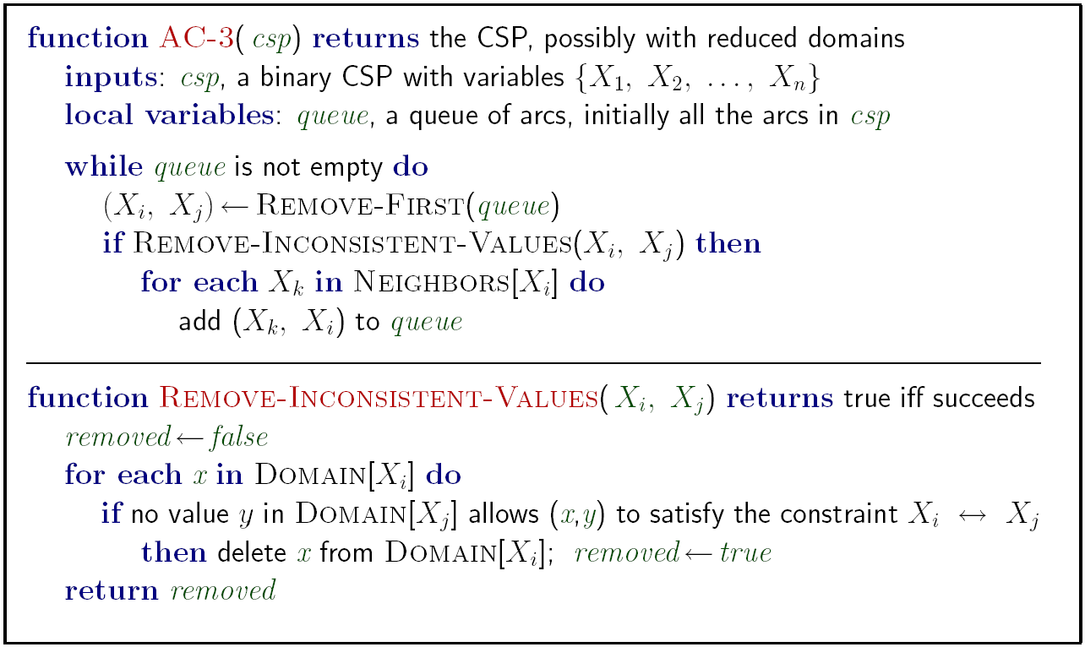
Enforcing Arc Consistency in a CSP
Runtime: O(n²d³), can be reduced to O(n²d²)
… but detecting all possible future problems is NP-hard – why?
[Demo: CSP applet (made available by aispace.org) -- n-queens]
Notes:
Auto-consistency (note initially nothing gets deleted/pruned since there are consistent options for all constraints for initial variable domains)
Flashes whenever something needs to be re-checked

Slide 38
Limitations of Arc Consistency
After enforcing arc consistency:
Can have one solution left
Can have multiple solutions left
Can have no solutions left (and not know it)
Arc consistency still runs inside a backtracking search!
What went wrong here?
[Demo: coloring -- forward checking]
[Demo: coloring -- arc consistency]
Notes:
Demo:
CS188 javascript demos -> source -> exercises -> csps -> CSPs demos -> CSPs demos.html
Settings:
Graph = Complex
Algorithm = Backtracking
Ordering = None
Filtering = Forward Checking (first) / Arc Consistency (second)

